Slide 1
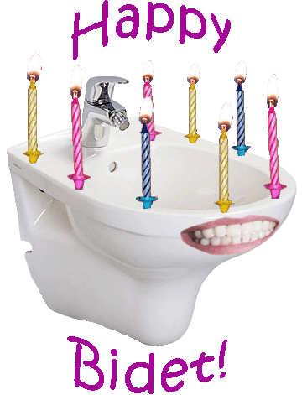
Bidet Seat Attachments
ASCIP presentation By: Laura Tarlova

Slide 2
Outline
Why use a bidet seat?
Research (more needed!!)
Types of bidets
Use with bathroom equipment
Case studies
Cleaning
Rehab engineering modifications

Slide 3
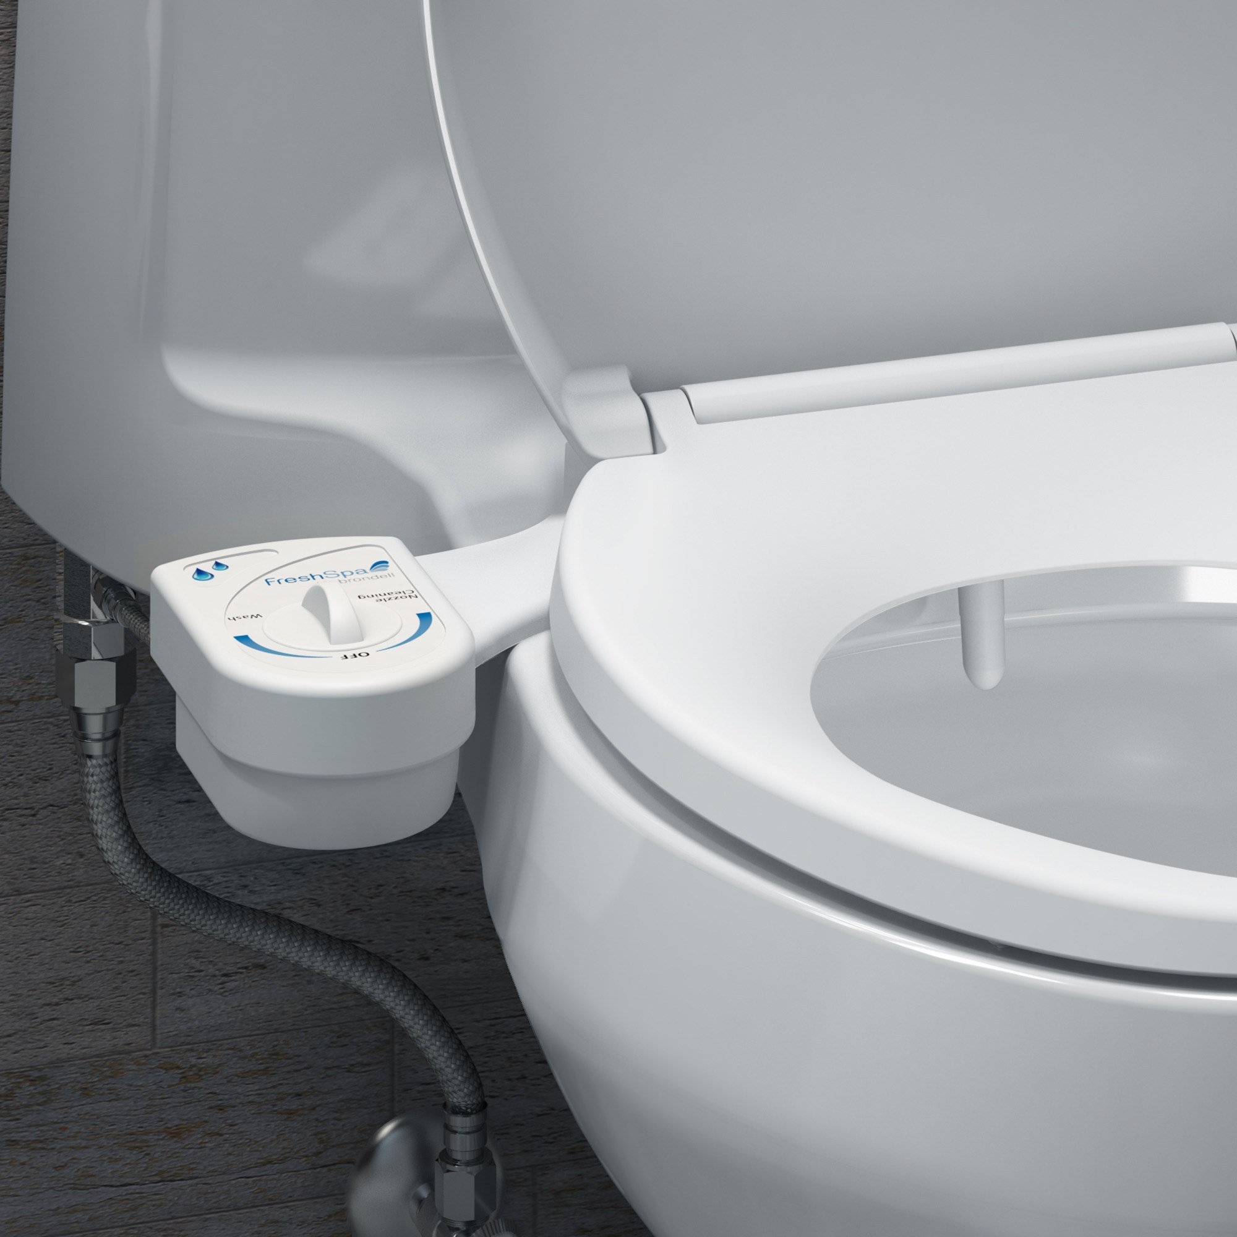
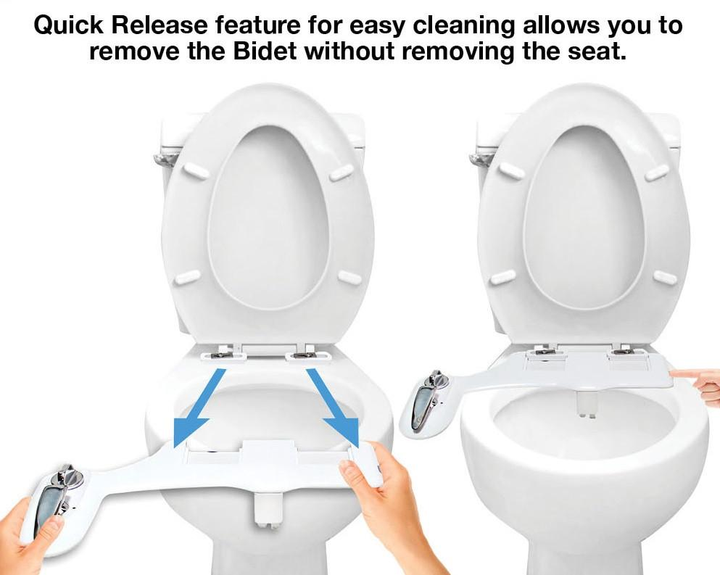
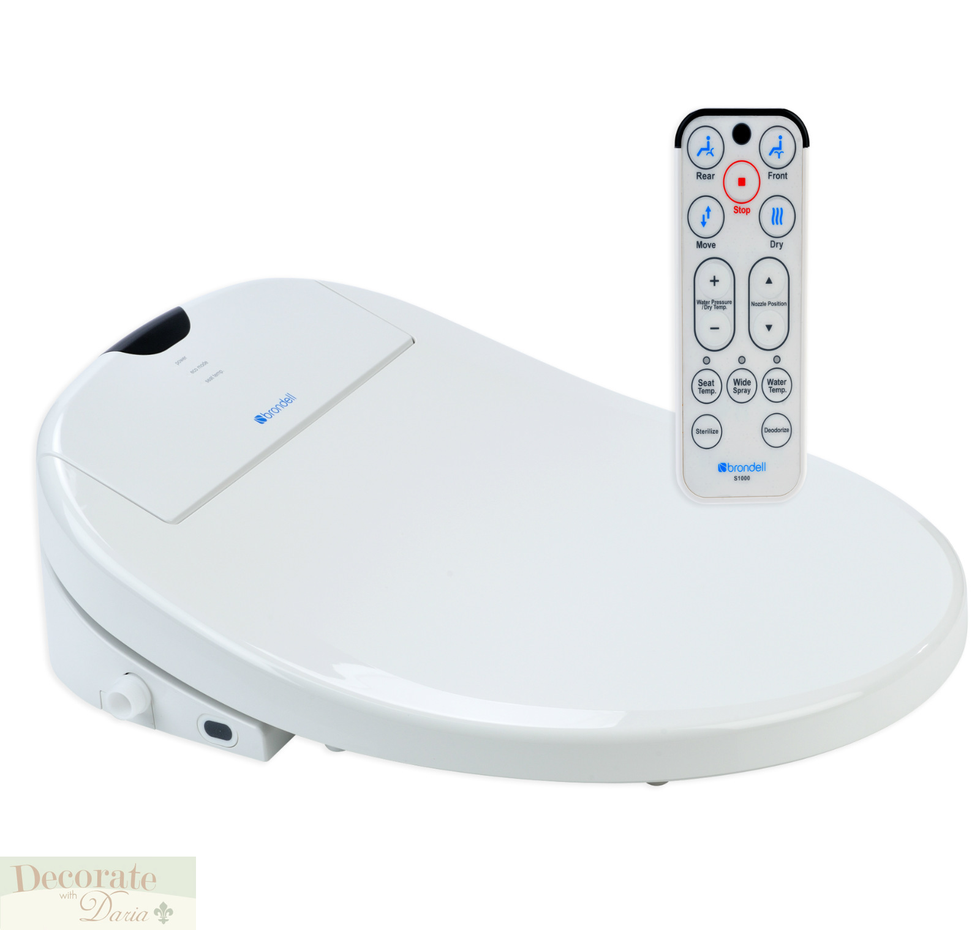
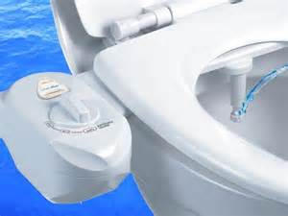
What is a bidet anyway?

Slide 4
Potential benefits of a bidet seat
List of potential benefits
DIGNITY: More independence/control/privacy
Decreased skin irritation (wiping can irritate sensitive skin)
More thorough cleaning
Feminine cleaning option
Decrease shoulder pain with reach
Decrease time needed for toileting
Fewer clogged toilets

Slide 5
Research: Very Limited!
Toileting for people in nursing homes
The use of bidets to reduce “anorectal pressures”
The use of bidet can be used to reduce anal resting pressure similar to a warm sitz bath
Only one on bidets and SCI population:
Pilot study on enema function of a bidet using a camera to target “target area” in 20 SCI subjects
Bowel movement was successfully induced using enema function in 15 of 20 patients

Slide 6
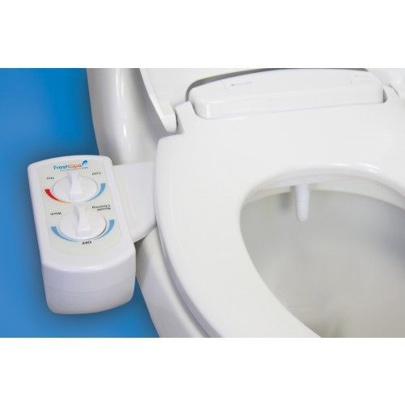
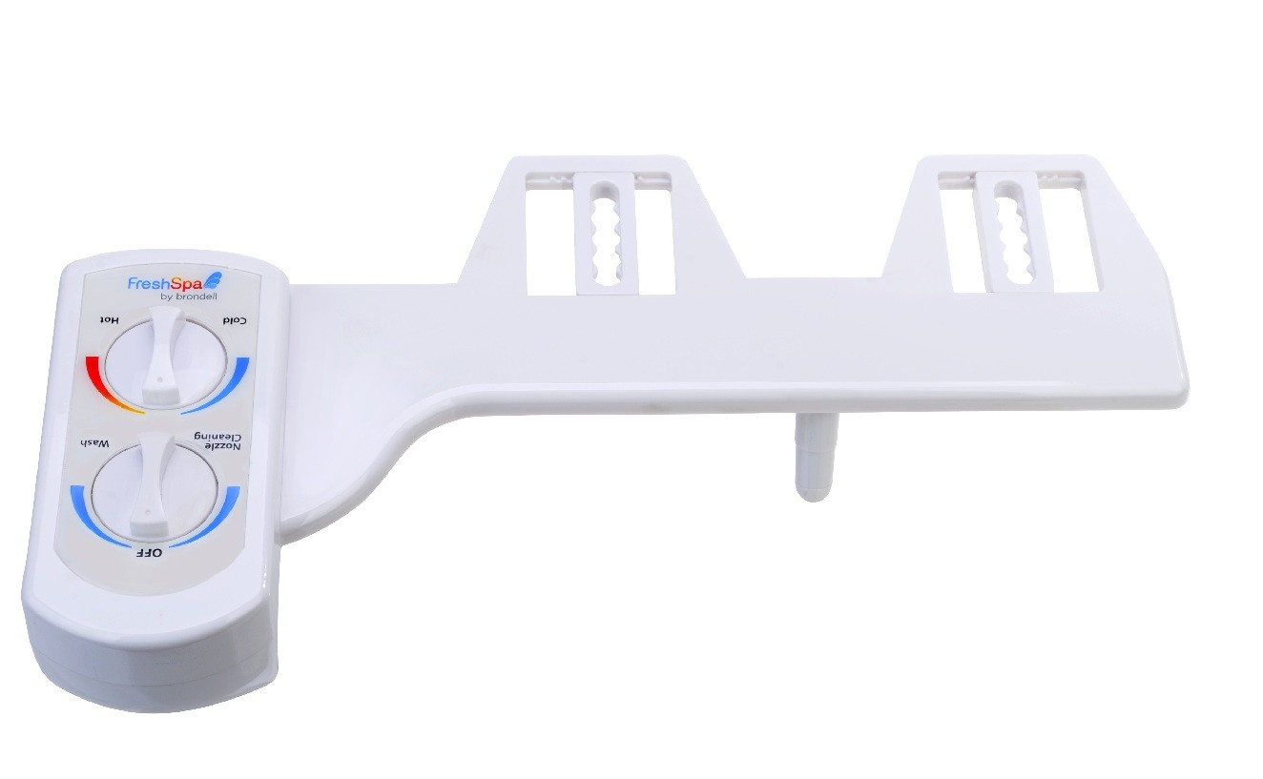
Types of bidet seats
Non-electric
$20 and up
Control attached
Turn knob to adjust spray intensity and water temp
Cold water (mostly)
Can hookup to warm water under sink
Tricky to use with bathroom equipment and bariatric patients

Slide 7
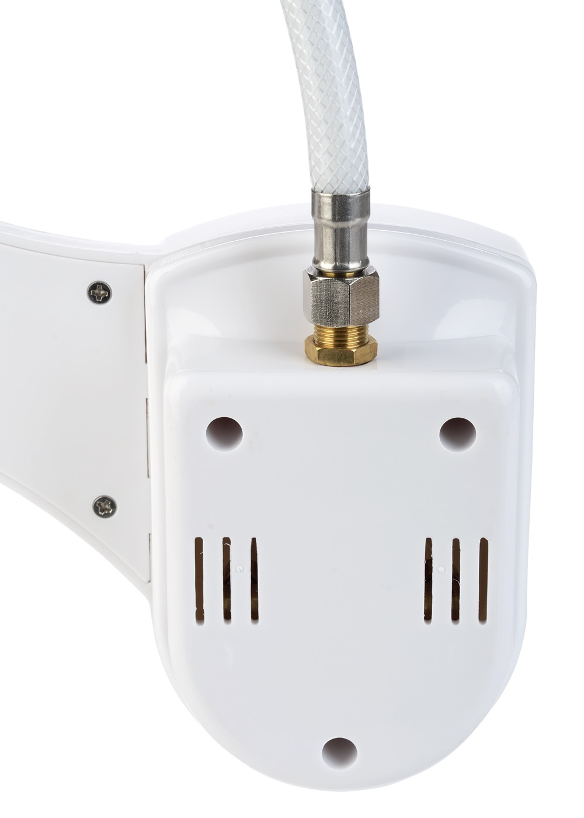
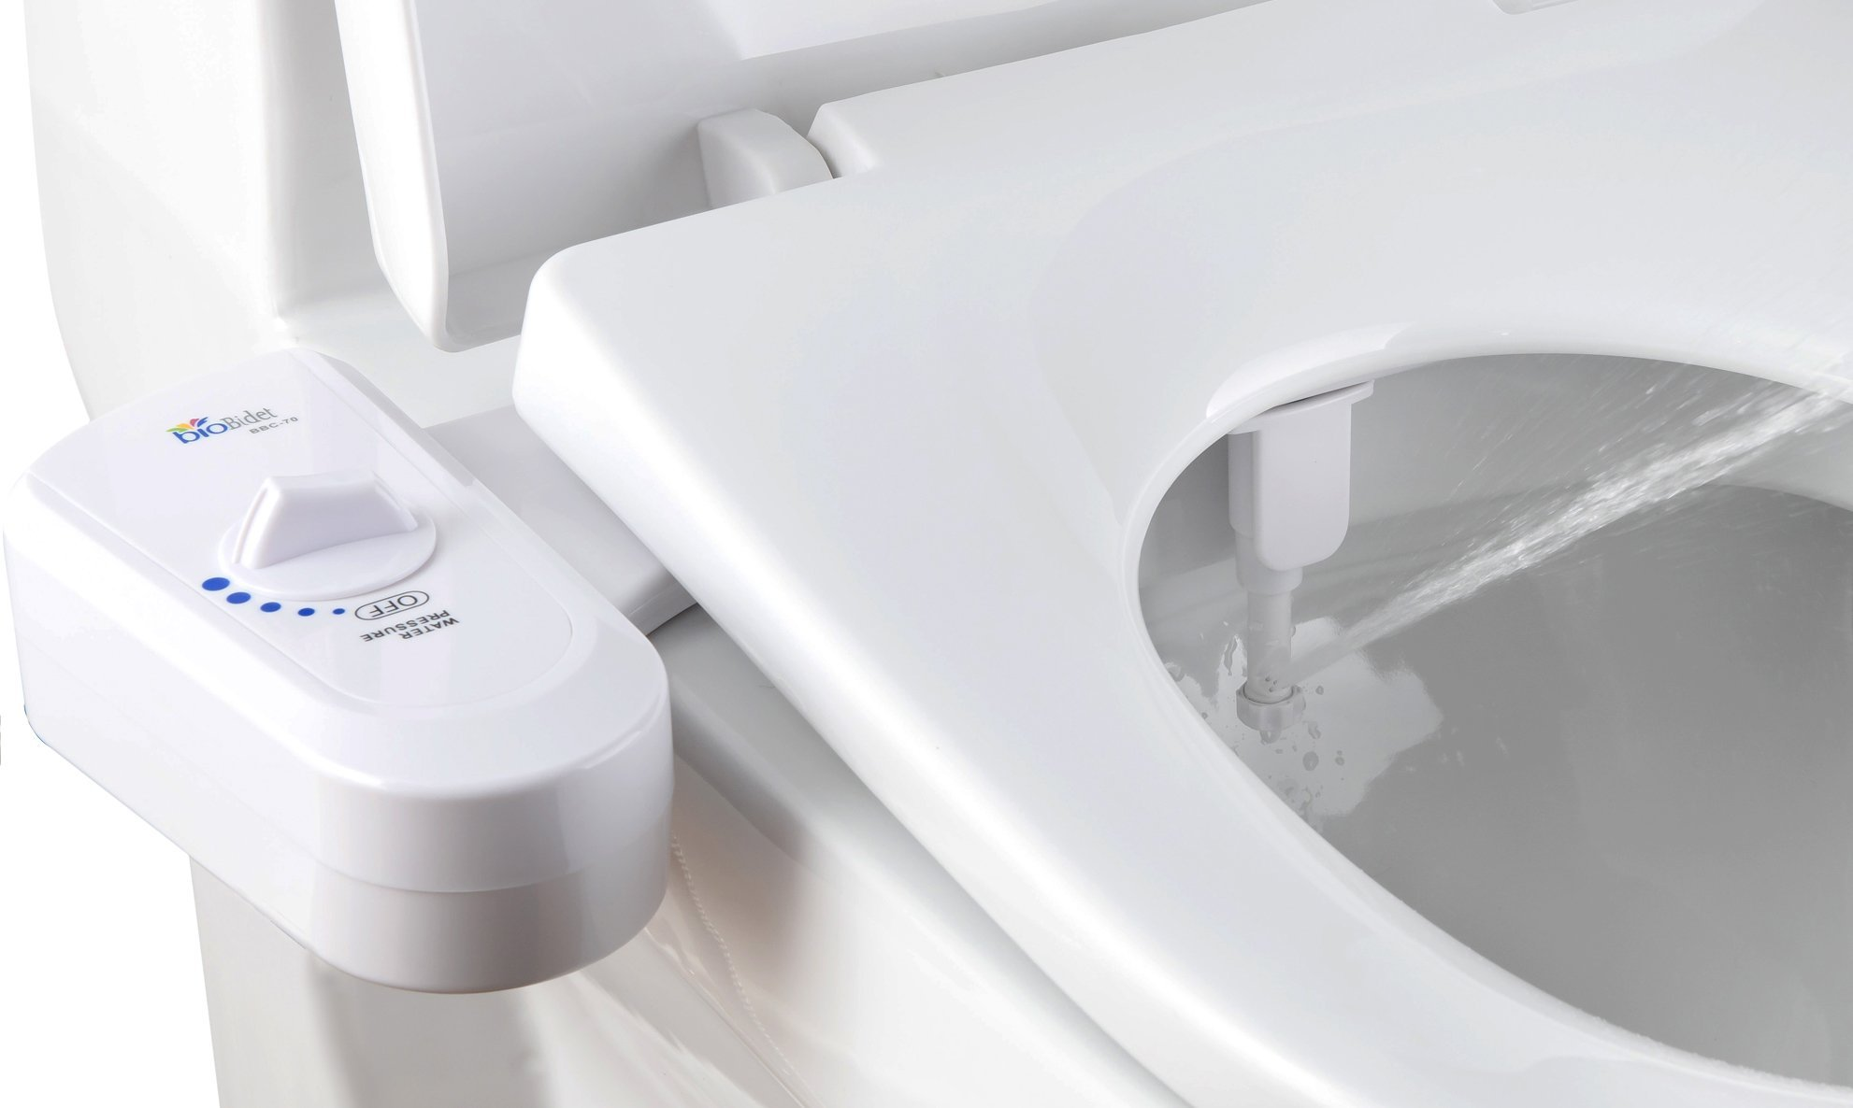
Installation: non-electric

Slide 8
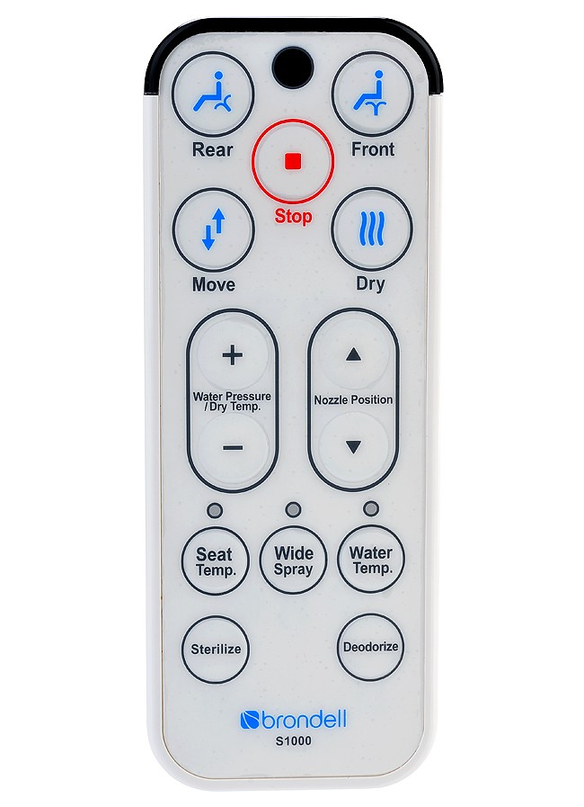
Electric
$200 and up
Entire seat and lid
Need power outlet
Water heater tank
No protruding control attachment
Push button remotes
Adjust spray intensity
Front/rear spray
Wide spray
Nozzle oscillation
Enema function
Dryer function

Slide 9
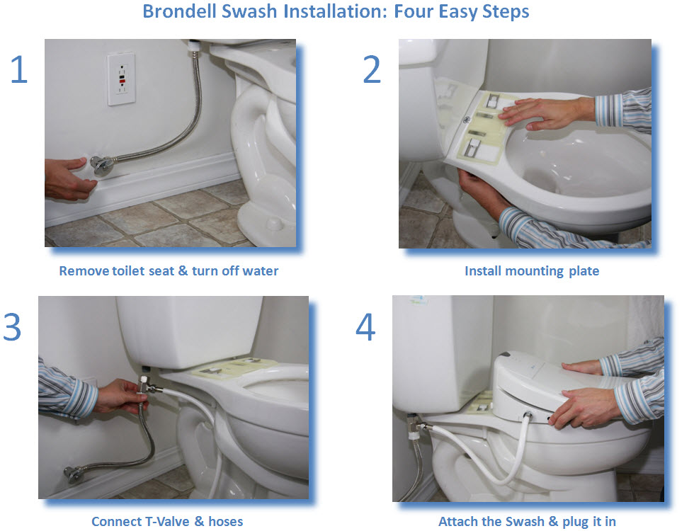
Installation:electric

Slide 10
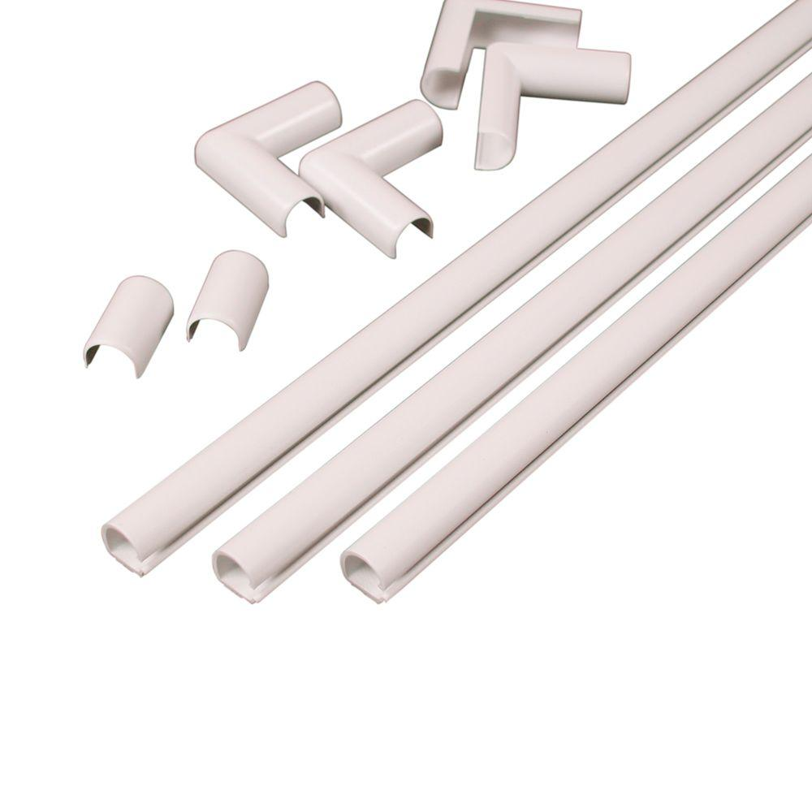
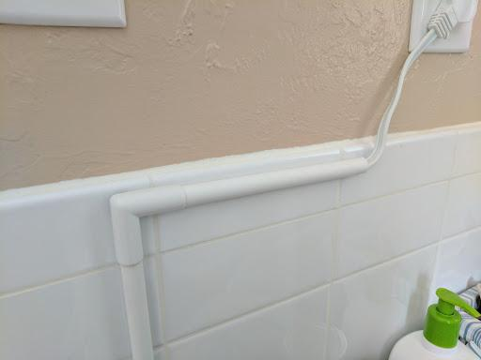
Cord Covers

Slide 11
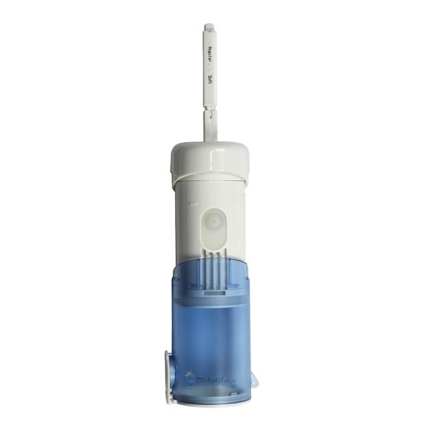
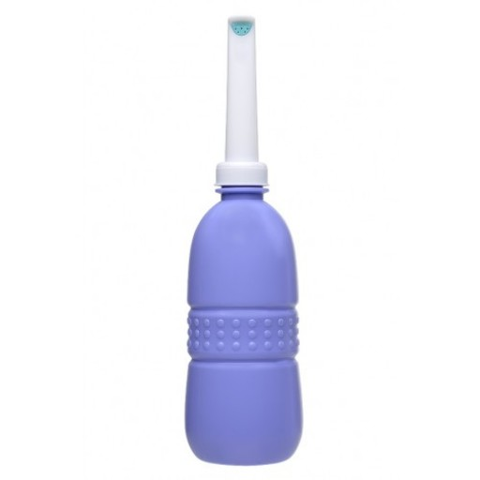
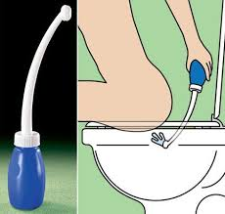
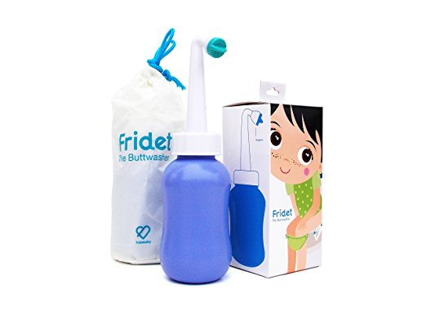
Portable Bidets
Squeeze Bottle: Brondell GoSpa $15
Battery Powered: Olympia Travel Bidet TB-300 $40

Slide 12
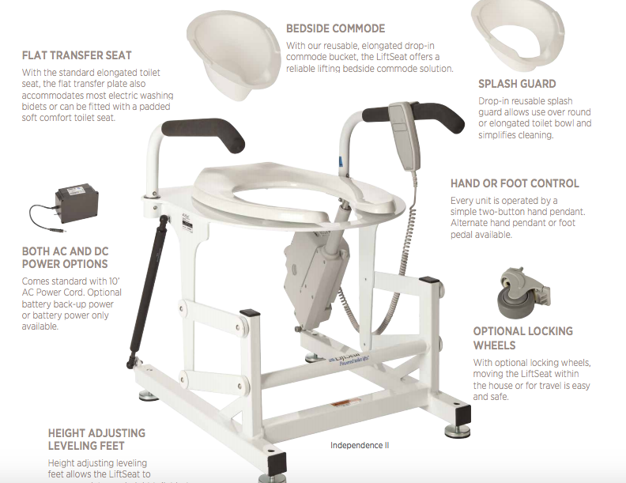
Other bidets
So many options!
Independence IV with electric wash
$1599 for lift plus $649 for Brondell 1000 attached to lift seat
All kind of accessories
Liftseat4home.com

Slide 13
Using Bidet seats with bathroom equipment
Both: Electric/non-electric
Change in spray target
Bidet with nozzle position adjustment
Electric:
Occupancy sensor
Non-electric:
Attached control panel blocking access
Right side only
Control panel hard to reach

Slide 14
Other bidet use skills
Drying
Dryer may not be thorough enough
Use mirror to check
Use towel or paper to dry
Similar techniques to drying after shower
May need caregiver help
Check for thoroughness
Learn what settings get the job done
Spray positioning/alignment
While drying pt may get insight on thoroughness
Remote control access
Pressing buttons: stylus in cuff, mouthstick, knuckle, velcro to wall or lap tray or positioning wedge

Slide 15
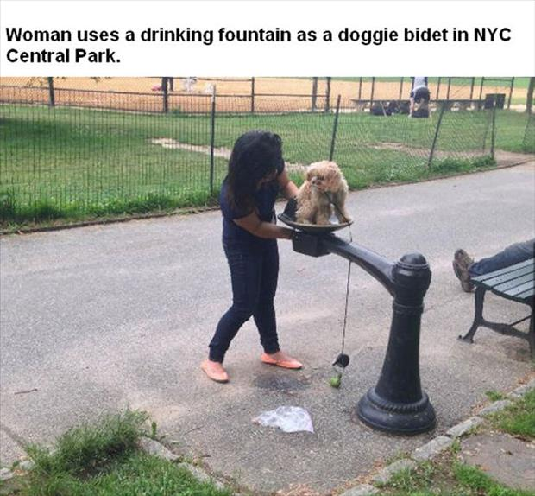
Where to purchase/educational handouts
Many online vendors
Amazon.com
Bidetking.com
Costco

Slide 16
Bidet seat options
Bidet type (electric/non-electric)
Dryer
Self cleaning
Remote control
Nozzle position adjustment
Enema
Warm water
Occupancy sensor

Slide 17
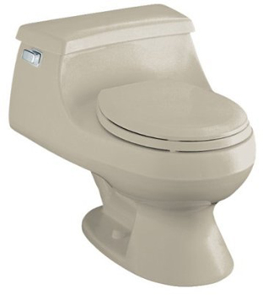
Purchasing considerations
Round or elongated/oval
French curve/1 piece toilet: provide model # to bidetking
All parts included (may need wrench/pliers)
Extension cord
Installation

Slide 18
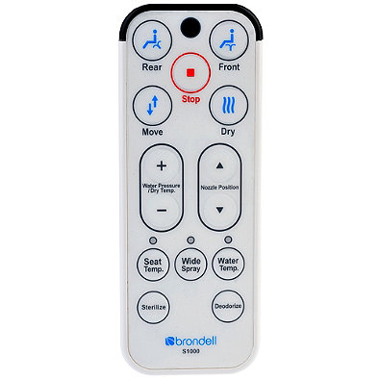
Bidets at Craig: Brondell Swash 1000
Disable occupancy sensor
Wide spray
Nozzle position adjustment
Dryer
Front wash
Sold online and at Costco
Sterilize option
Deodorize
$499-$599

Slide 19
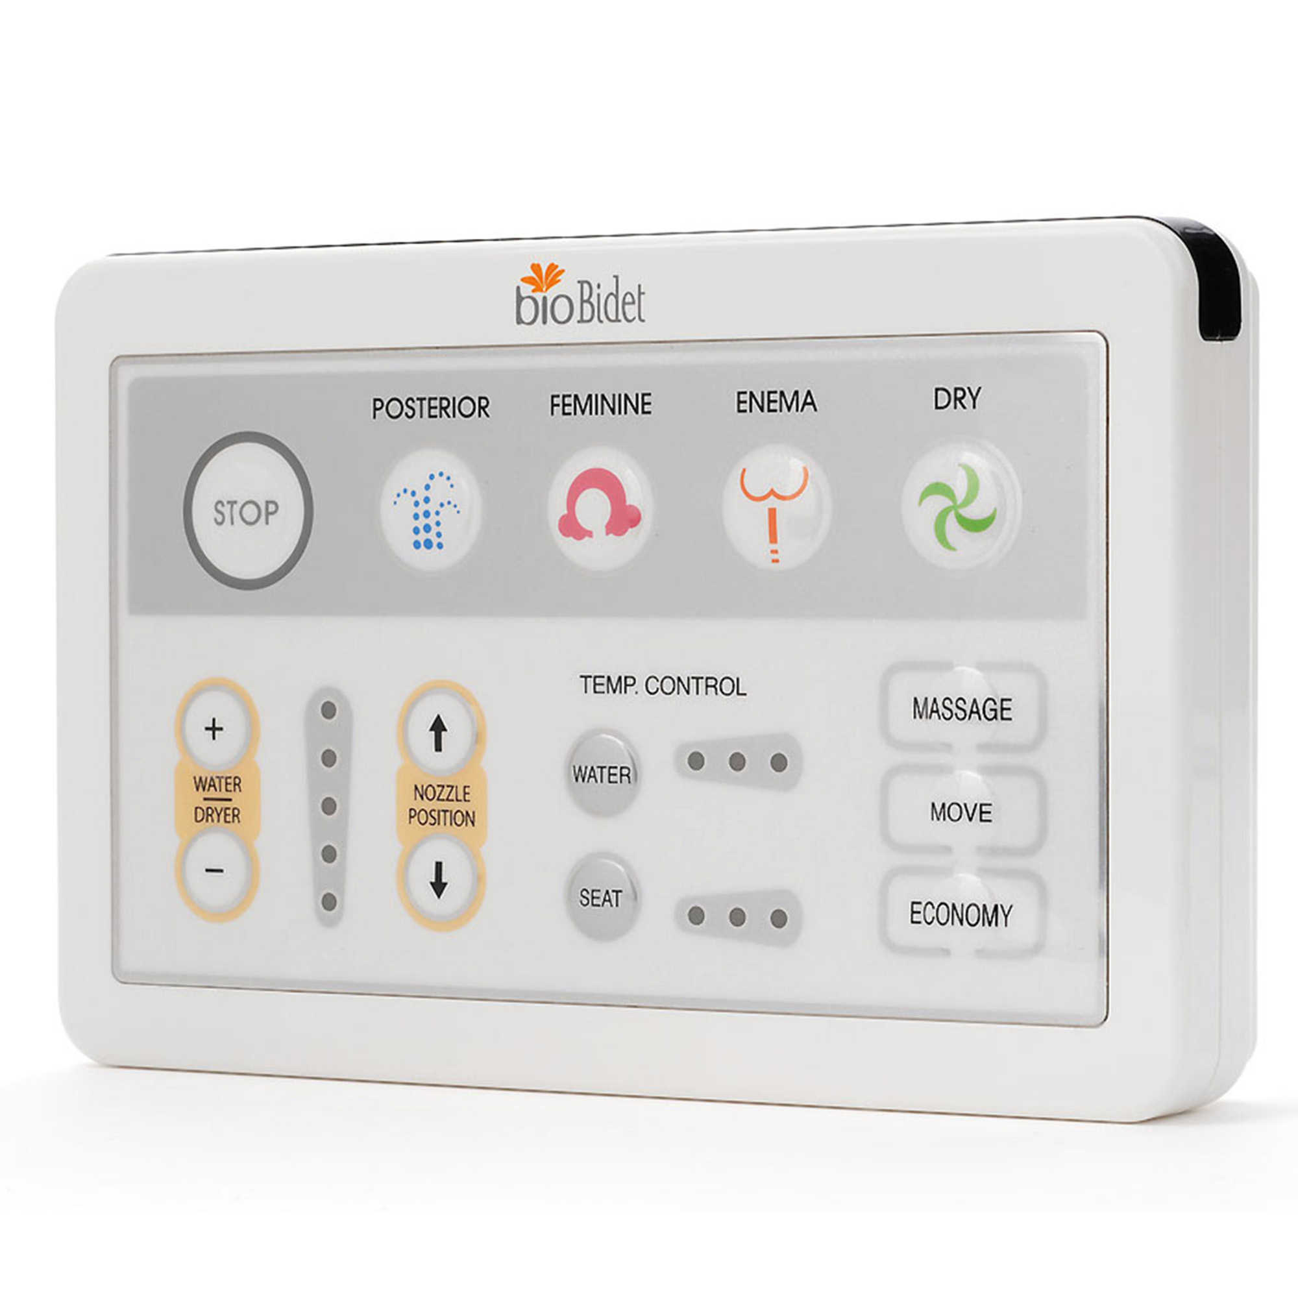
Bidets at Craig: BioBidet 1000
Larger buttons and remote
Enema function
Dryer
Clear feedback on adjustments
Cannot disable occupancy sensor
Automatic nozzle sterilization
Automatic deodorizer
$499

Slide 20
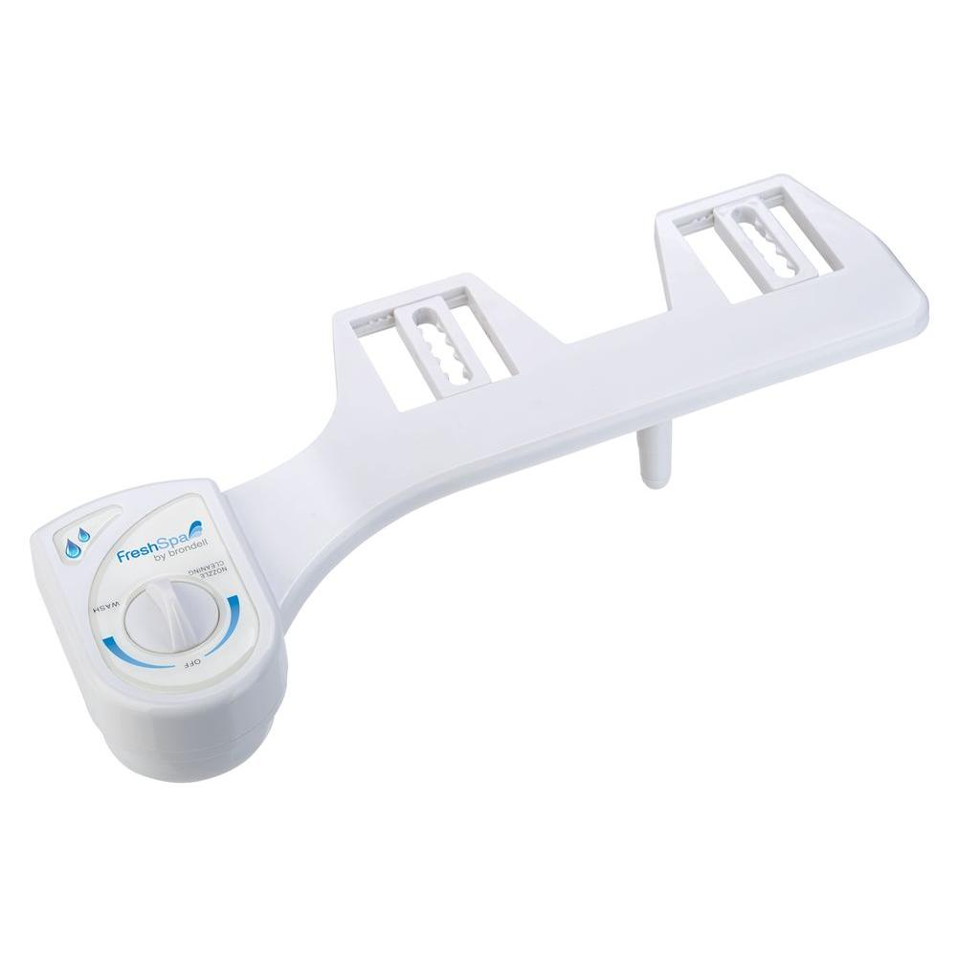
Bidets at Craig: Brondell FreshSpa ($40-$60)
Nonelectric
Nozzle adjustment: manual
Spray intensity
Nozzle cleaning
Cold water only
$59

Slide 21
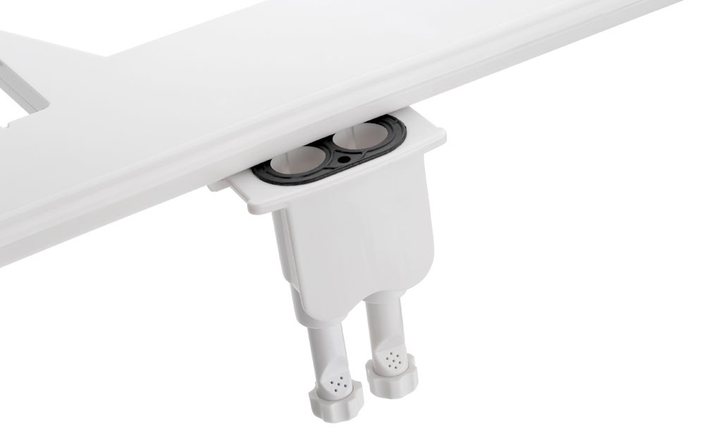
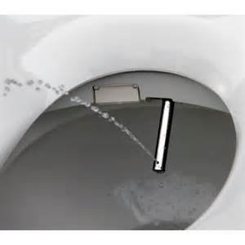
Cleaning the bidet
No regular cleaning required for home use
Nozzles easily accessible, sometimes replaceable
Self cleaning feature
Craig hospital cleaning procedure

Slide 22
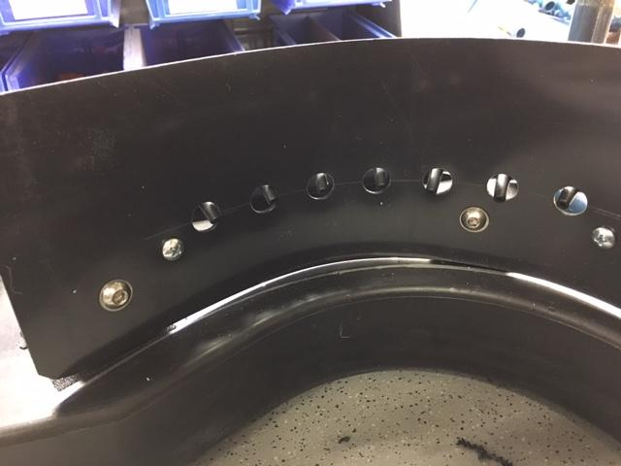
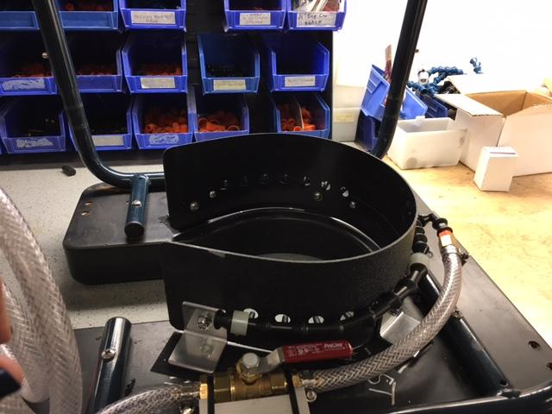
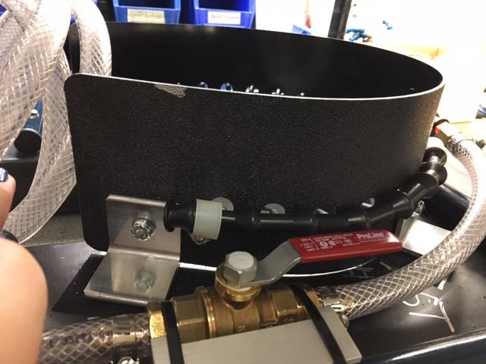
Rehab Engineering

Slide 23
Rehab Engineering
Modify turn knobs and buttons
Splash guard
Attaching seat directly to SCC/RTS
Non-electric: Spray nozzle off center
Electric: back end too tall
If someone needs a cut out you cannot cut the bidet lid to accommodate

Slide 24
Feedback from patients with incomplete injury
Four tetra-incomplete injury patients (3 using non-electrics, one electric):
-Saves time
-Increased ease with cleanup due to limited UE ROM
-More gentle on the skin
-Decreased shoulder pain

Slide 25
Patient feedback: C5 ASIA D
“I would highly recommend it [a bidet]. It saves me a lot of work, time, and issues with shoulder pain… I even have shoulder pain while driving my car so anything I can do to decrease the amount of reach and work I have to do is great...It’s one less thing you have to worry about that can fatigue you.”

Slide 26
Incomplete injury feedback continued
Other feedback (reported by one incomplete injury patient)
-Helps stimulate a bowel movement
-Helps in particular with loose stool cleanup
-Dont have to worry about toilet getting clogged

Slide 27
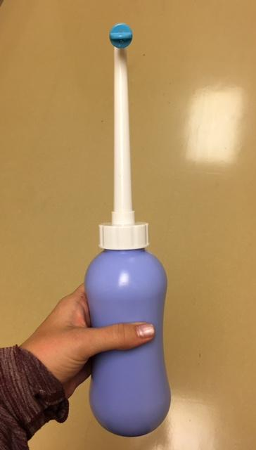
Case study: portable bidet
Used by 2 patients with T10 and T12 ASIA A injury
Couldn't reach due to TLSO or muscle tightness
Using long handled equipment for BOP
Using The Palm by bioBidet
Longest spray spray nozzle ‘’7
Squeeze powered
Their feedback:
Use in combination with toilet paper
More gentle on skin rash
Felt this assisted with getting “cleaner”

Slide 28
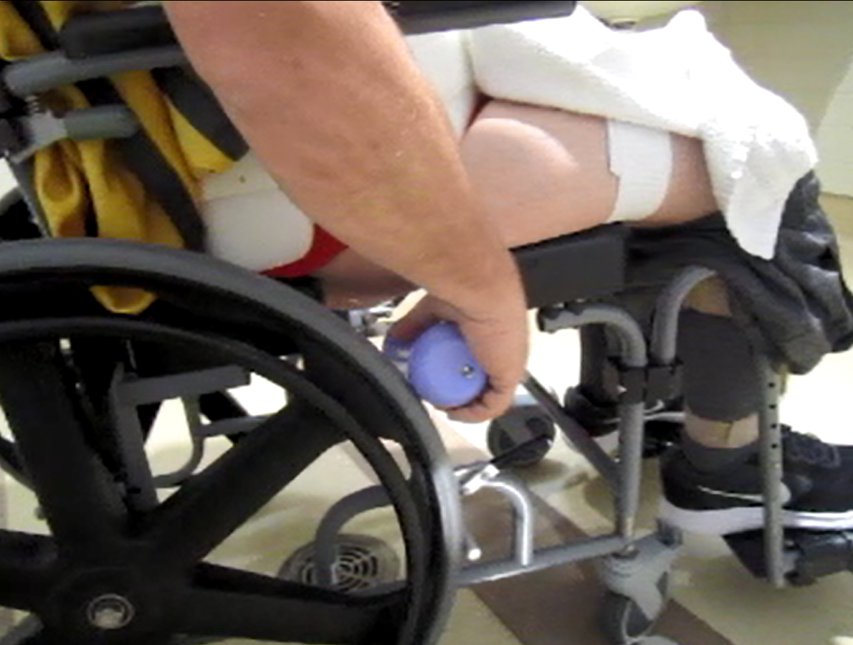
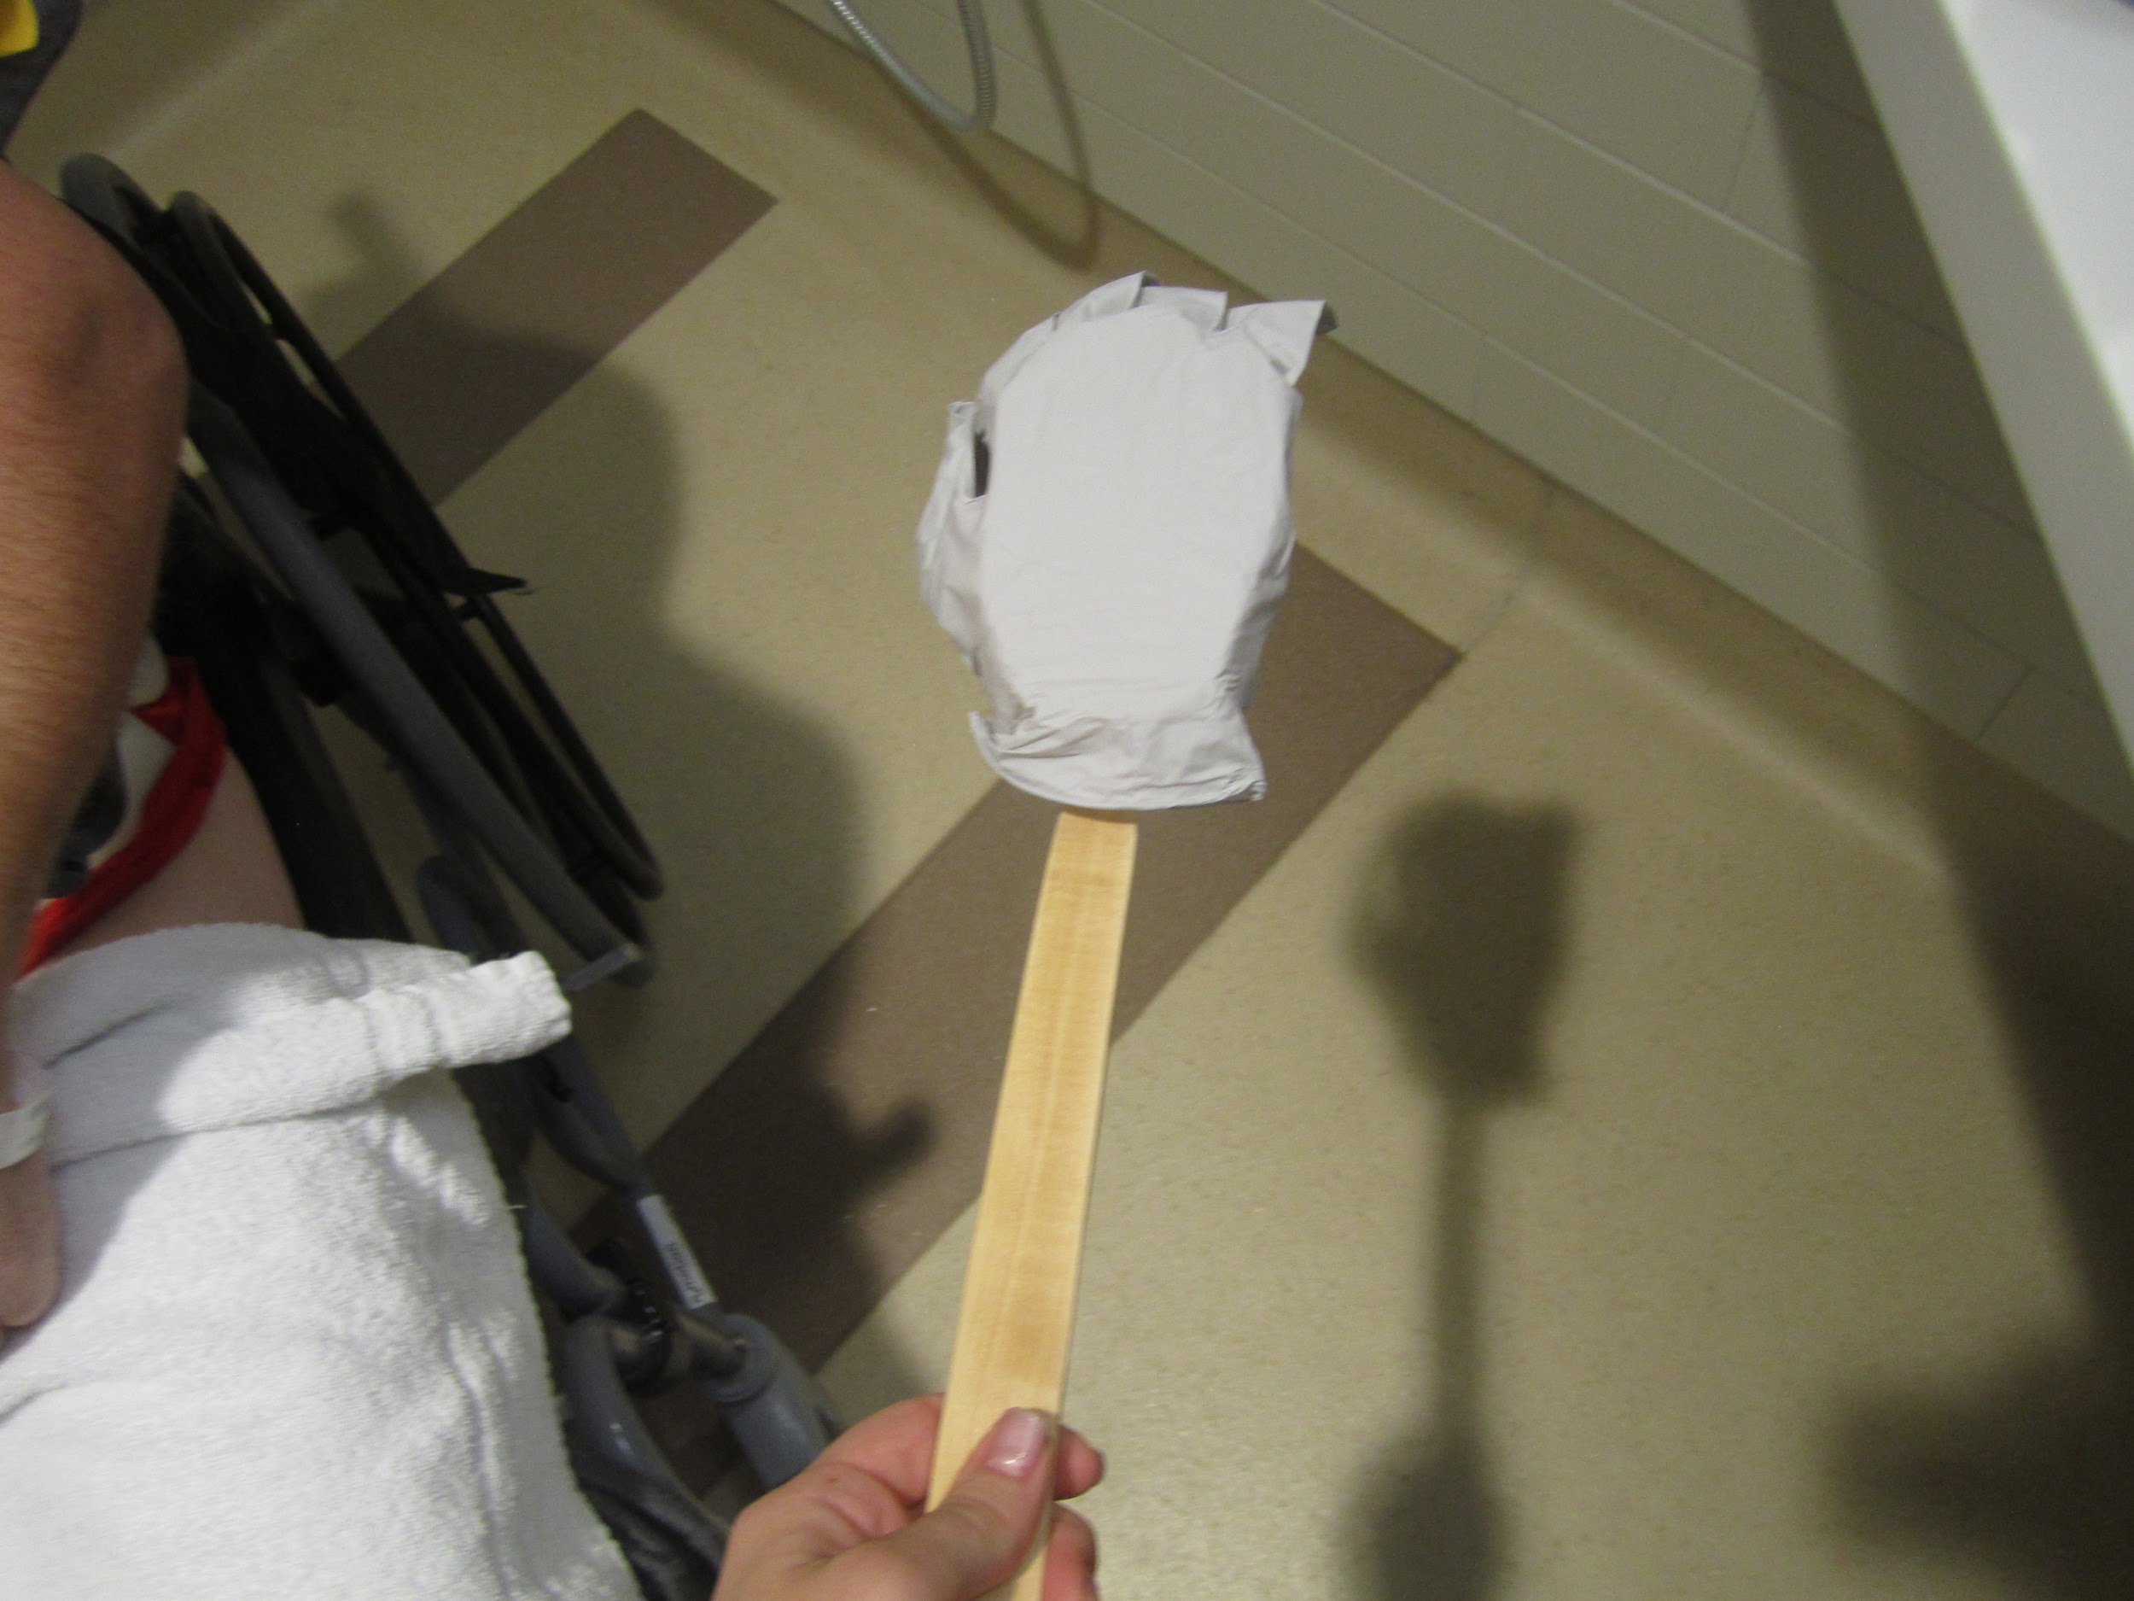
Case study: portable bidet

Slide 29
Case study: Guillain-Barre
Female patient, concerned about wiping after urination
Limited functional upper extremity movement (unable to wipe)
Had control of bladder and ability to transfer to/from toilet
Experience using Biobidet 1000 (not using RTS or SCC)
Used mouthstick stylus to operate remote
Place remote on wall, mouthstick nearby in a jar on shelf
Good trunk control: lean forward for feminine wash
Wear skirts and underwear with cutout

Slide 30
Other patient uses at/after Craig
Hip replacement precautions
Patients with loose stool/C-diff
Multiple family caregivers
Brain injury patient with functional use of left hand to operate remote
Needed help with transfer but wanted pericare privacy

Slide 31
Questions??

